Slide 1
Nervous Activity Analyzer
By Vicktoria Antonova & Anne Leijsen
Biological Signals, May 2013

Slide 2
Overview of Presentation
Our Task
Graphical User Interface (GUI)
Matlab code
Discussion
Conclusion

Slide 3
Our Task:
Digital filtering of a raw EEG signal
Extraction of alpha, beta, theta, delta waves from a filtered EEG signal
Computation of STD, AVG and CC
Implementation in Matlab, if possible with an interactive GUI
User should be able to import the raw signal import from a Biopac text export
User should be able to enter the sampling frequency
User should be able to filter the raw signal
User should be able to execute alpha, beta wave, theta, delta wave computation using Fourier or Wavelet transform or digital filtering
User should be able to execute STD, AVG, CC computation
User should be able to display plots of the raw signal for a given start and end timestamp
User should be able to display plots of alpha, beta wave, theta, delta waves over the time for a given start and end timestamp and display the values for STD, AVG and CC

Slide 4
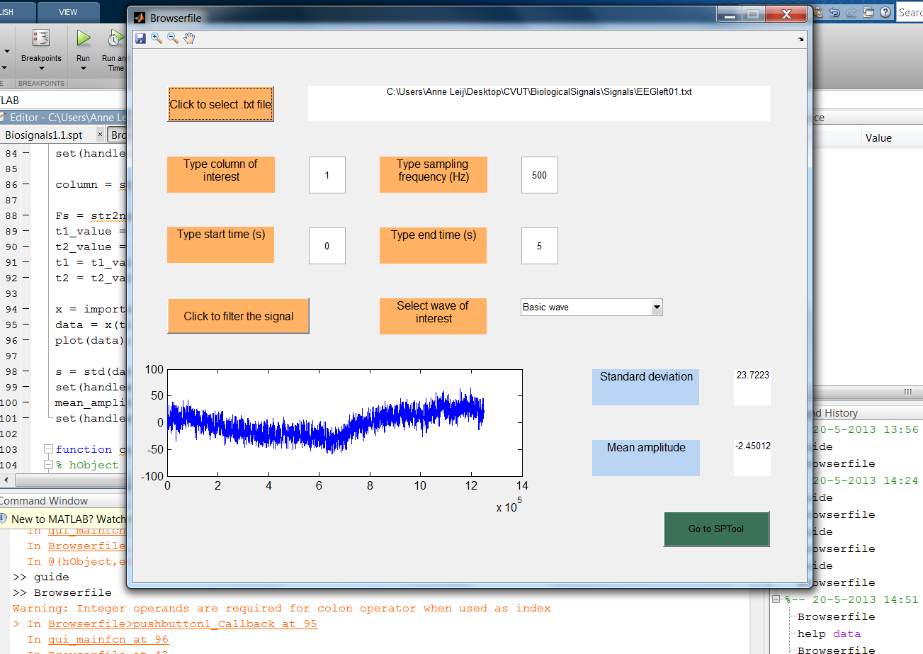
Graphical User Interface

Slide 5
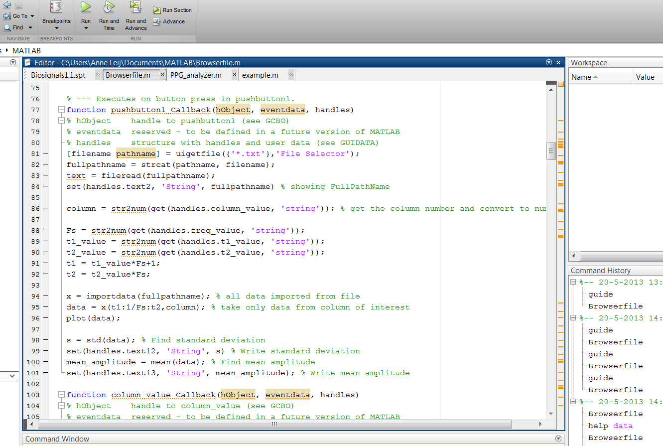
Matlab Code

Slide 6
Discussion
Program is made for .txt files (exported e.g. from Biopac), this should be taken into account using the program.
Data should be properly formatted (use of .).
Mention the right data column.
Button refers to SPTool to change filter design (advanced users).
Cycle Count is not showed, no wavelet transform.

Slide 7
Conclusion
Program is working for available data.
With future improvement, the Nervous Activity Analyzer could be used as part of e.g. ambulatory EEG recording.

Slide 8
Nervous Activity Analyzer
The new user interface for EEG recording
Thank you for your attention.
Are there any questions?

